Slide 1
Symmatric Key Cryptography Project Using Caeser Cipher
Simple explanation of the working of project
Gautam Suraj CSE AI 7th Sem 42

Slide 2
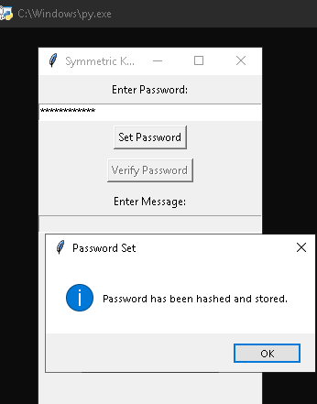
Step 1 : Password Hashing
1> Enter any password 2> Set the password and it will be turned into an unintelligible text. (Safe and secure which is now beyond comprehension) 3> Verifying the password correctly will further unlock the parts of program otherwise it will stop.

Slide 3
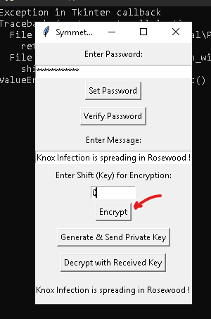
Step 2: Encryption Of The Message
1> Enter the confidential text that is to be encrypted in the ‘Enter Message’ field. 2> Add a shift value manually to get the encrypted text as per the Caeser cipher algorithm. Caeser Cipher: (Adding 0 will show the text as it is because Caeser algorithm shifts every letter of the text to the upcoming letters in the alphabet series as per the provided shift value and 0 will shift none of them. In the code part ‘bcrypt’ module makes it easy)

Slide 4
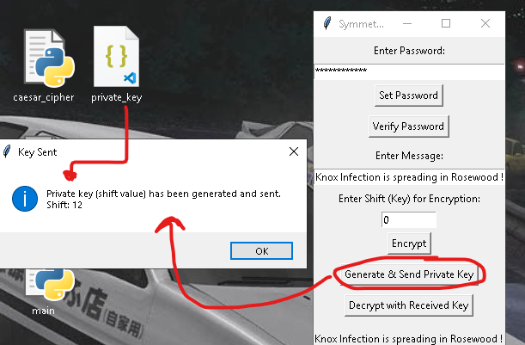
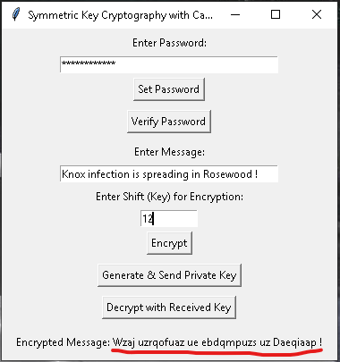
Step 3 : Generating The Private Key
1> Press on ‘Generate & Send Private Key’, this will create a .json file which contains the shift value which was randomly chosen to encrypt the message. It’s 12 for this text. 2> Enter the chosen shift value to the ‘Enter Shift’ field and this will give the encrypted text 3> Copy the encrypted text and send it to the receiver via the unknown sources along with the private key file.

Slide 5
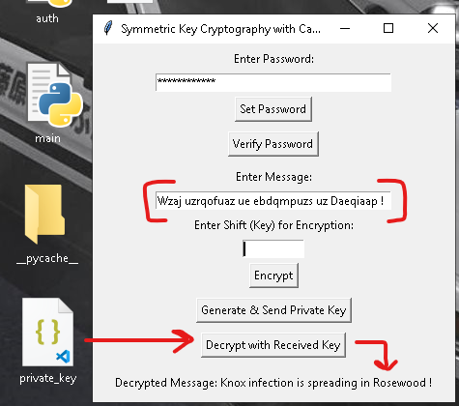
Step 4 Decryption Of The Message
1> Now from the point of view of the receiver, enter the received encrypted text into the ‘Enter Message’ field. 2> Get the private key to it’s right destination folder which is the location where the encryption program files are placed. 3> Press the Decrypt with Received Key’ button and it will decrypt the encrypted message for you using the shift value provided through the private key. (For the sake of simplicity, the string in the private key file is simple without salting)

Slide 6
Dependencies
1> bcrypt library is used for hashing function. 2> tkinter is used for gui
Thank You

